Slide 1

OPTIMIZED CROP AND FERTILIZER RECOMMENDATIONS USING MACHINE LEARNING FOR SUSTAINABLE AGRICULTURE
By
Name 1: Neelam Divya Gangotri ( 219E1A3370 )
Name 2: Mavuluru Abhiram Reddy ( 219E1A3362 )
Name 3: Poreddy Keerthana (219E1A3384 )
Name 4: Mada Hari Krishna ( 29E1A3358 )
Name 5: Podili Harish ( 219E1A3383 )
Under the guidance of
Dr.J SARADA
Associative Professor
DEPARTMENT OF COMPUTER SCIENCE AND ENGINEERING (AI & ML)
SRI VENKATESWARA ENGINEERING COLLEGE
( JNTUA Affiliated )
Karakambadi Road, Tirupati-517507
2021-2025

Slide 2
OUTLINE
Abstract
Introduction
Problem Statement
Existing system
Disadvantages
Proposed system
Advantages
System Requirements
Modules
UML Diagrams
Project Implementation
Testing
Results

Slide 3
ABSTRACT
Efficient agricultural practices are essential to meet the growing demands for food production while preserving environmental resources. This project focuses on developing a machine learning-based system that provides accurate crop and fertilizer recommendations tailored to specific regions and soil characteristics. By analyzing historical and regional data, the system identifies complex relationships between environmental factors, crop types, and fertilizer requirements, enabling farmers to make data-driven decisions. Advanced algorithms, including CatBoost and Artificial Neural Networks (ANN), are utilized for classification and prediction, ensuring high accuracy and reliability. CatBoost enhances performance by efficiently handling categorical and numerical agricultural data, while ANN captures complex non-linear relationships for improved recommendations. The proposed system promotes precision agriculture, helping farmers optimize resource usage, reduce costs, and enhance crop productivity. Furthermore, this approach contributes to sustainable farming by minimizing the overuse of fertilizers and mitigating environmental degradation. By bridging technology and agriculture, the project addresses critical challenges in food security, resource management, and ecological balance, fostering long-term agricultural sustainability.

Slide 4
INTRODUCTION
Agriculture is the backbone of food security and economic stability, yet it faces challenges like resource scarcity, environmental degradation, and climate change.
Traditional farming methods often rely on generalized recommendations, leading to inefficiencies and overuse of resources.
With the advent of machine learning, there is an opportunity to revolutionize agriculture by providing data-driven crop and fertilizer recommendations tailored to specific regional and soil conditions.
This project integrates advanced machine learning algorithms to analyze environmental and agricultural data, fostering sustainable farming practices and addressing global agricultural challenges.

Slide 5
PROBLEM STATEMENT
Farmers often struggle to make accurate decisions regarding crop selection and fertilizer usage due to a lack of region-specific, data-driven recommendations.
Current practices rely heavily on traditional methods, leading to inefficient resource utilization, higher costs, and environmental degradation.
There is an urgent need for a scalable and precise system that offers optimized recommendations for crops and fertilizers based on soil characteristics, climate, and other relevant factors, ensuring sustainability and productivity.

Slide 6
EXISTING SYSTEM
Current systems for crop and fertilizer recommendations are either manual or rely on generalized data, which lacks precision.
Some systems use basic algorithms for analysis but fail to account for complex interactions between environmental factors, crop types, and fertilizer requirements.
These systems often require significant manual intervention and lack adaptability to regional variations, limiting their effectiveness in promoting precision agriculture.

Slide 7
DISADVANTAGES
Generalized Recommendations: Lack of specificity to regional and soil conditions.
Limited Accuracy: Basic algorithms fail to capture complex relationships in data.
High Resource Usage: Inefficient resource allocation due to poor recommendations.
Environmental Impact: Overuse of fertilizers leading to soil degradation and pollution.
Scalability Issues: Existing systems are not scalable for large datasets or diverse regions.

Slide 8
PROPOSED SYSTEM
The proposed system leverages machine learning algorithms like Cat boost and ANN to provide optimized crop and fertilizer recommendations.
By analyzing historical data, soil characteristics, and climatic conditions, the system identifies patterns and relationships to offer precise recommendations.
It includes features for continuous learning and adaptability to new data, ensuring scalability and reliability.
The system promotes sustainable agriculture by optimizing resource usage, reducing costs, and mitigating environmental harm.

Slide 9
ADVANTAGES
Tailored Recommendations: Provides region-specific and soil-specific guidance.
High Accuracy: Utilizes advanced algorithms for precise predictions.
Cost-Effective: Reduces unnecessary resource expenditure.
Sustainability: Promotes eco-friendly practices by minimizing fertilizer overuse.
Scalable and Adaptable: Handles large datasets and adapts to new data seamlessly.
User-Friendly: Easy-to-use interface for farmers and agricultural stakeholders.

Slide 10
SYSTEM REQUIREMENTS
HARDWARE REQUIREMENTS:
PROCESSOR : Intel I5
RAM : 8GB
HARD DISK : 100 GB

Slide 11
SOFTWARE REQUIREMENTS
PYTHON IDE : Anaconda Jupyter Notebook
BACK END : Jupyter Notebook
FRONT END : Django framework
PROGRAMMING LANGUAGE : Python

Slide 12
MODULES
Data collection
Data pre processing
Data cleaning
Data prediction and forecasting
Data splitting
Training and testing

Slide 13
MODULES
Data Collection
Data is gathered from diverse sources, including historical agricultural datasets, soil profiles, climate records, and fertilizer usage patterns. This ensures comprehensive input for building a robust machine learning model.
Data Preprocessing
Collected data is transformed into a usable format by handling missing values, encoding categorical variables, and normalizing numerical data. This step ensures the data is clean and consistent for analysis.
Data Cleaning
Irrelevant, redundant, or noisy data is removed to enhance the quality and accuracy of the dataset. This process reduces errors and ensures reliable predictions.

Slide 14
MODULES
Data Prediction and Forecasting
Machine learning models predict optimal crops and fertilizers based on soil and climatic conditions. These predictions help farmers make informed decisions for future farming cycles.
Data Splitting
The dataset is divided into training and testing subsets, typically in a 70:30 ratio. This ensures the model is trained effectively while reserving data for validation.
Training and Testing
Machine learning algorithms like Cat boost and ANN are trained on the prepared data. The trained models are then tested to evaluate their accuracy and reliability in real-world scenarios.

Slide 15
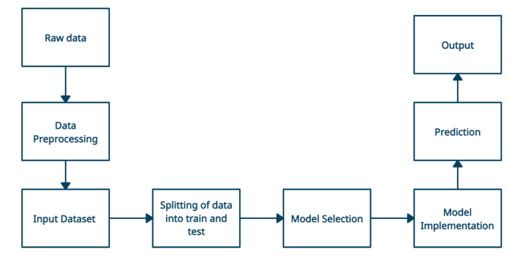
ARCHITECTURE

Slide 16
DESIGN WITH UML DIAGRAMS

Slide 17
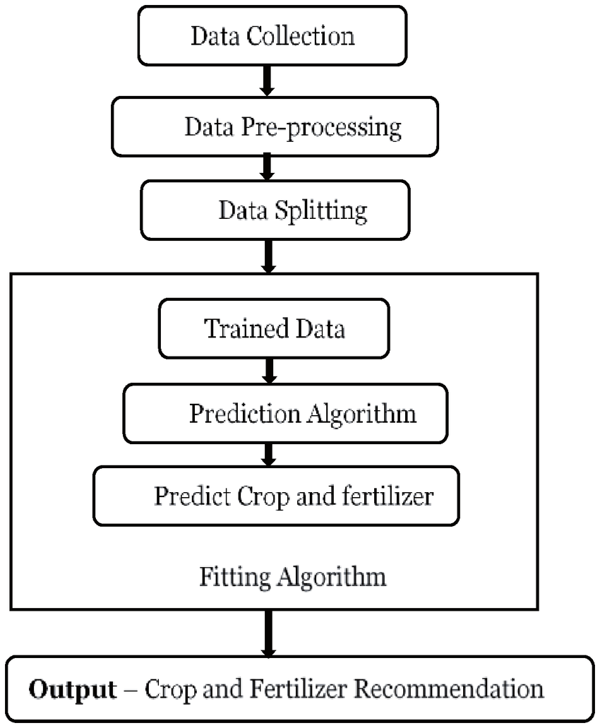
DATA FLOW DIAGRAM

Slide 18
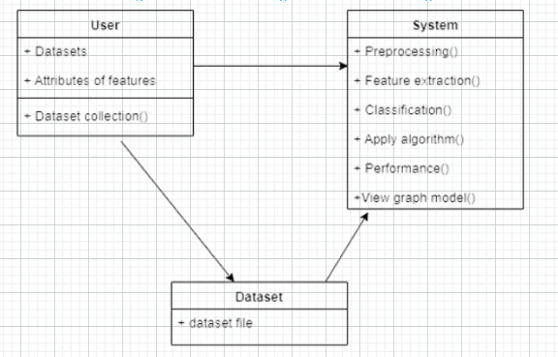
CLASS DIAGRAM
Class diagram is a type of static structure diagram that represents the fundamental architecture of the system.
Fig : Class Diagram

Slide 19
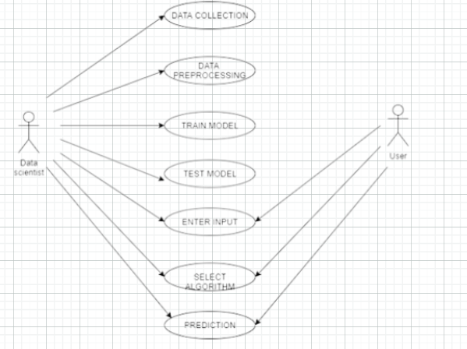
USECASE DIAGRAM
Use cases are a set of actions, services and functions that the system needs to perform.
Fig : Usecase Diagram

Slide 20
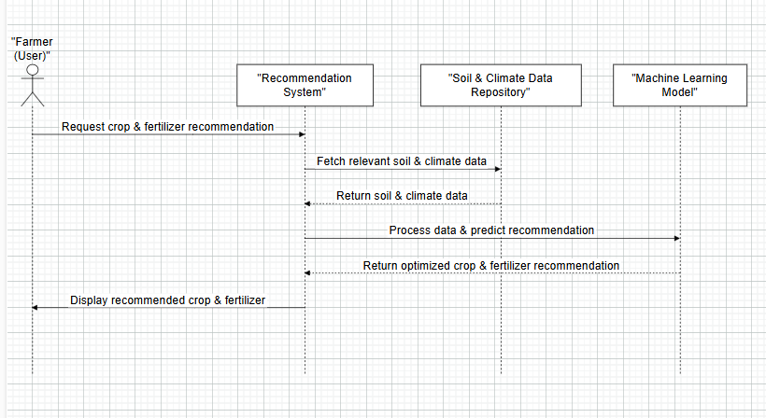
SEQUENCE DIAGRAM
Sequence diagrams describe interactions among classes in terms of exchange of messages over time.
Fig : Sequence Diagram

Slide 21
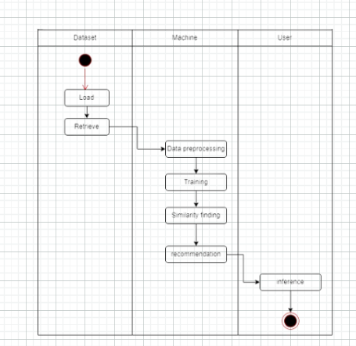
ACTIVITY DIAGRAM
Activity diagram is basically a flow chart to represent the flow from one activity to another activity
Fig : Activity Diagram

Slide 22
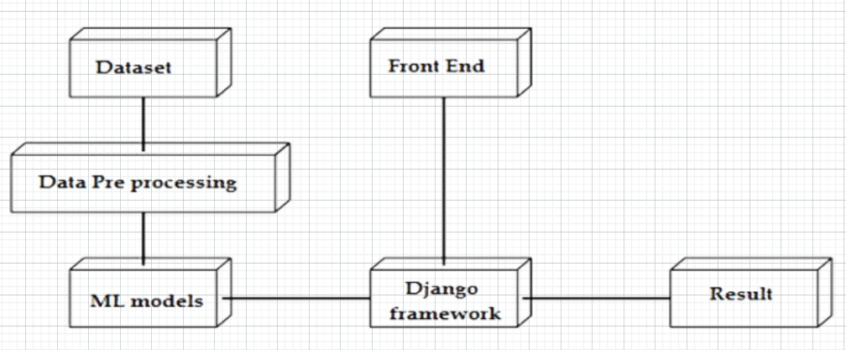
DEPLOYMENT DIAGRAM
A Deployment Diagram in UML shows the physical architecture of a system, depicting hardware nodes, software components, and their interactions. It illustrates how system components are deployed across hardware resources for execution.

Slide 23
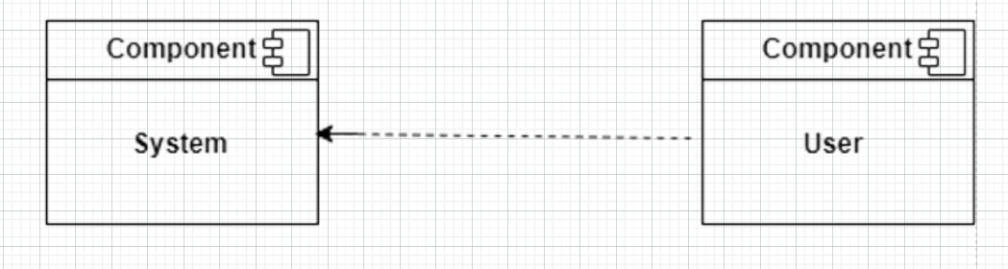
COMPONENT DIAGRAM
A Component Diagram in UML visualizes the physical components of a system, including software modules, their relationships, and dependencies. It illustrates how components interact and are deployed within the system’s architecture.

Slide 24
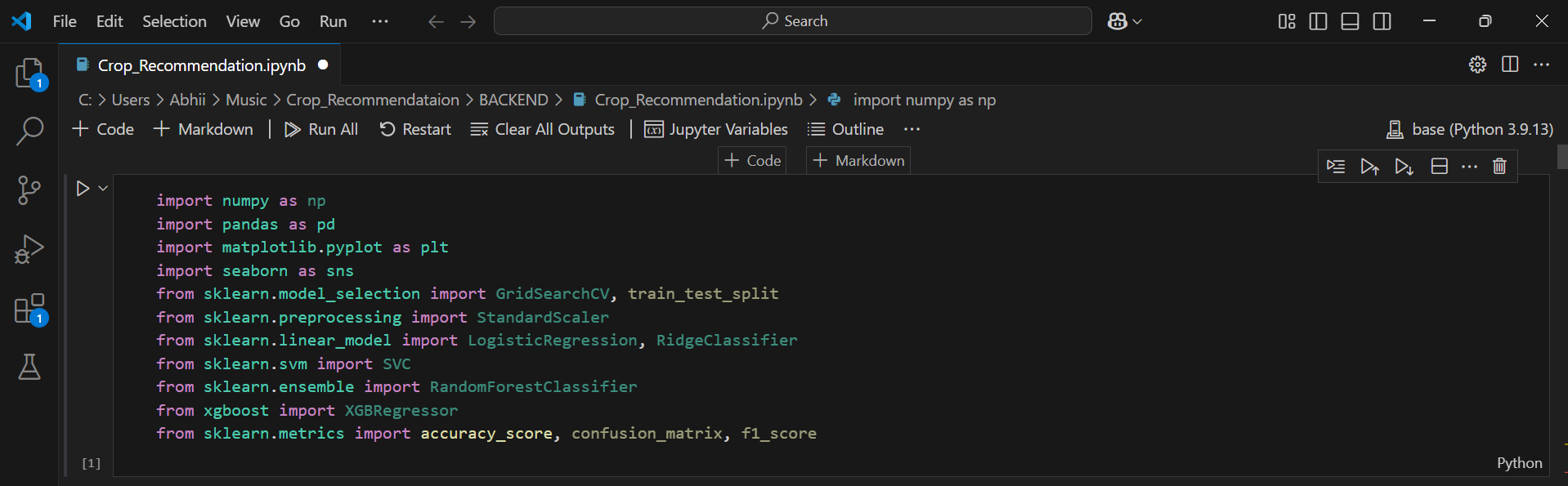
PROJECT IMPLEMENTATION

Slide 25
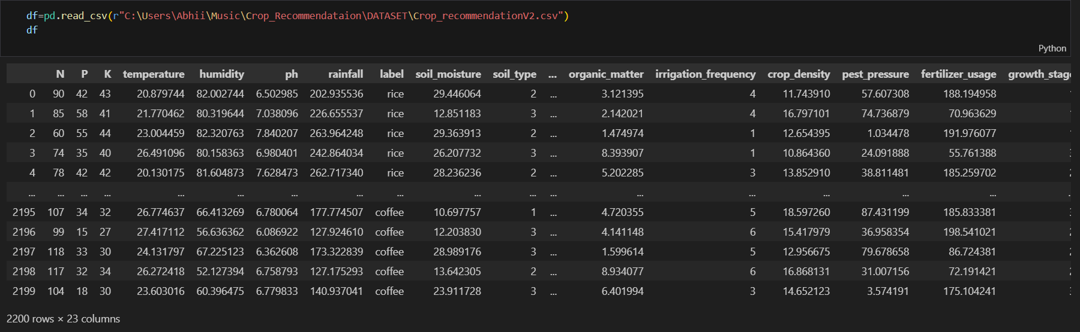
PROJECT IMPLEMENTATION

Slide 26
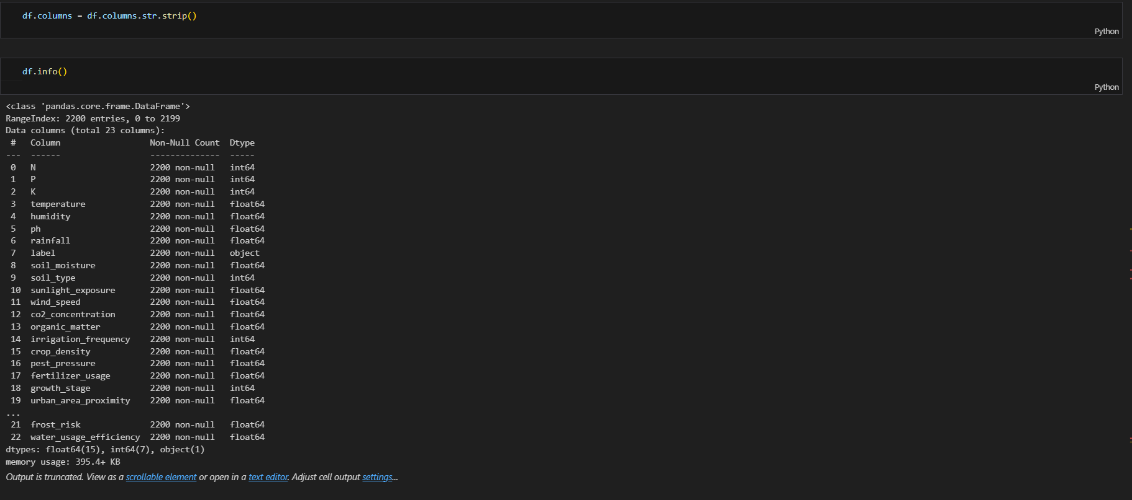
PROJECT IMPLEMENTATION

Slide 27
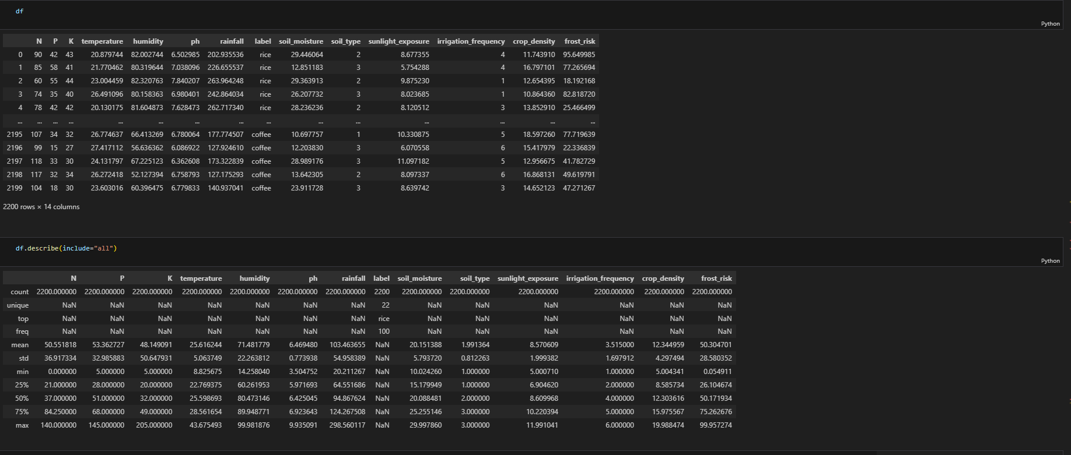
PROJECT IMPLEMENTATION

Slide 28
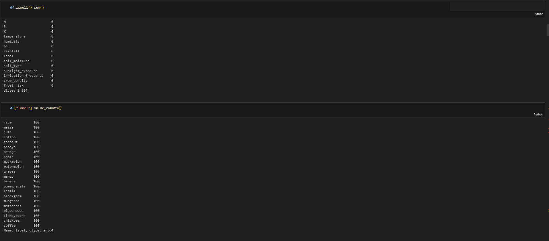
PROJECT IMPLEMENTATION

Slide 29
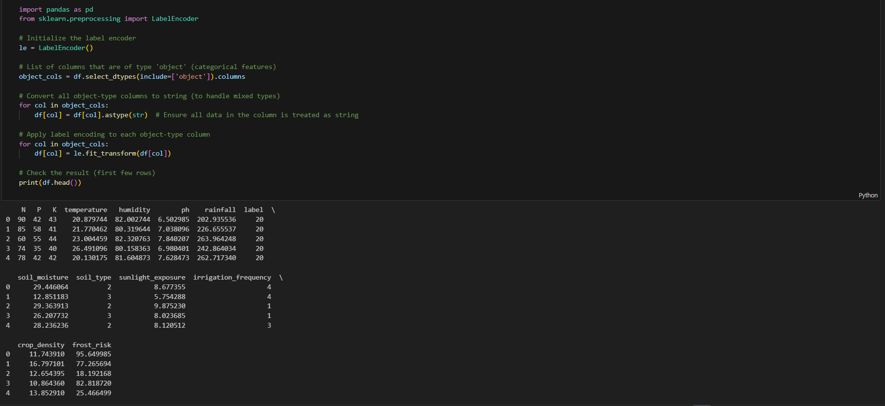
PROJECT IMPLEMENTATION

Slide 30
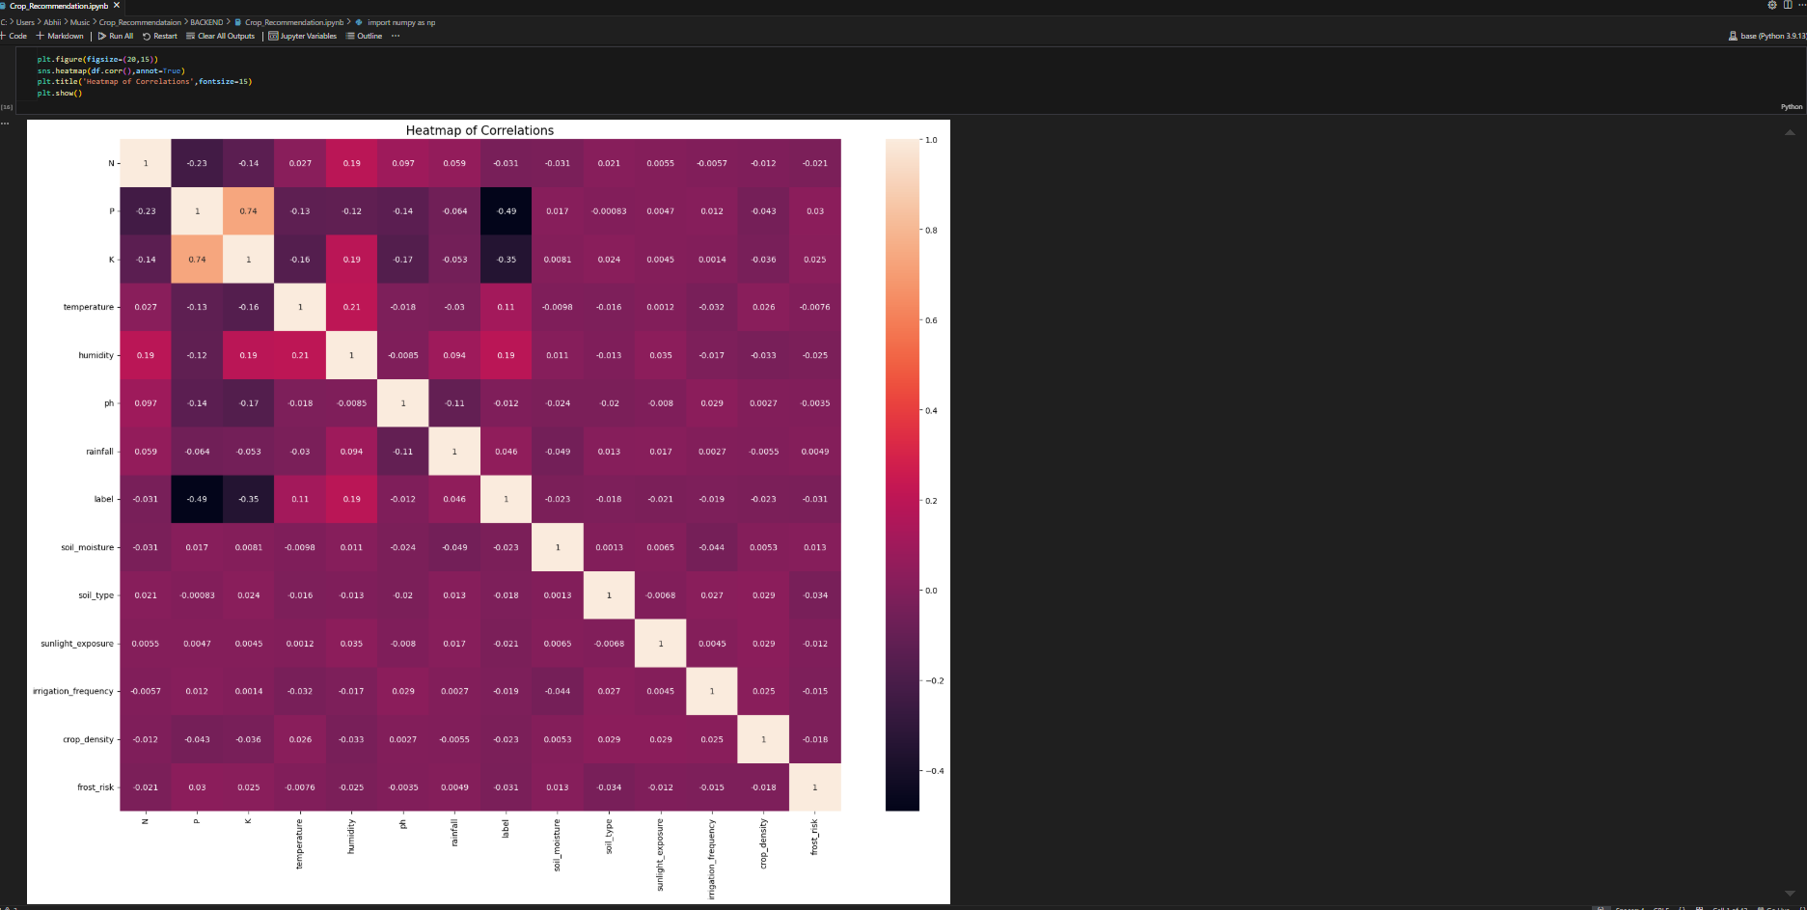
PROJECT IMPLEMENTATION

Slide 31
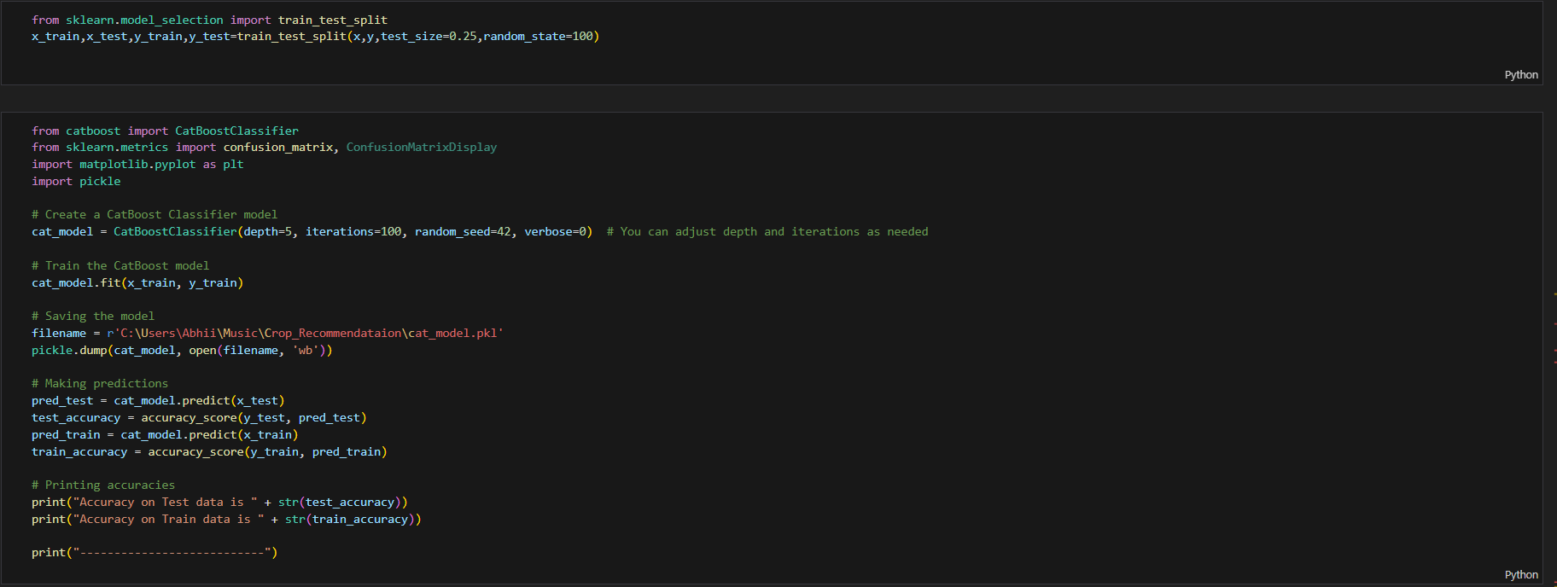
PROJECT IMPLEMENTATION

Slide 32
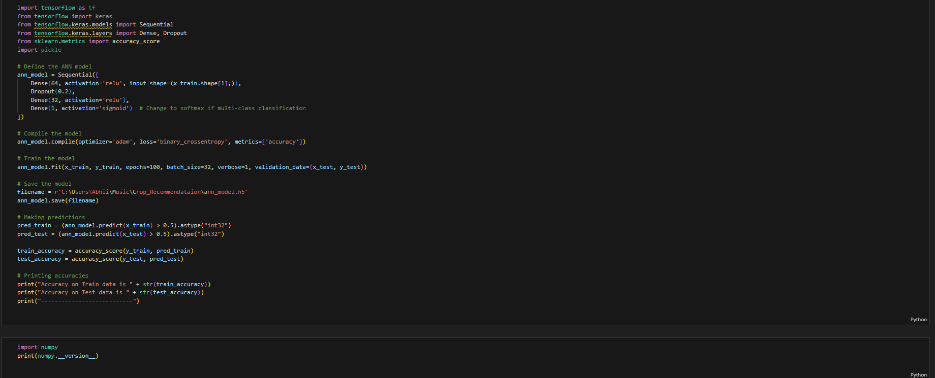
PROJECT IMPLEMENTATION

Slide 33
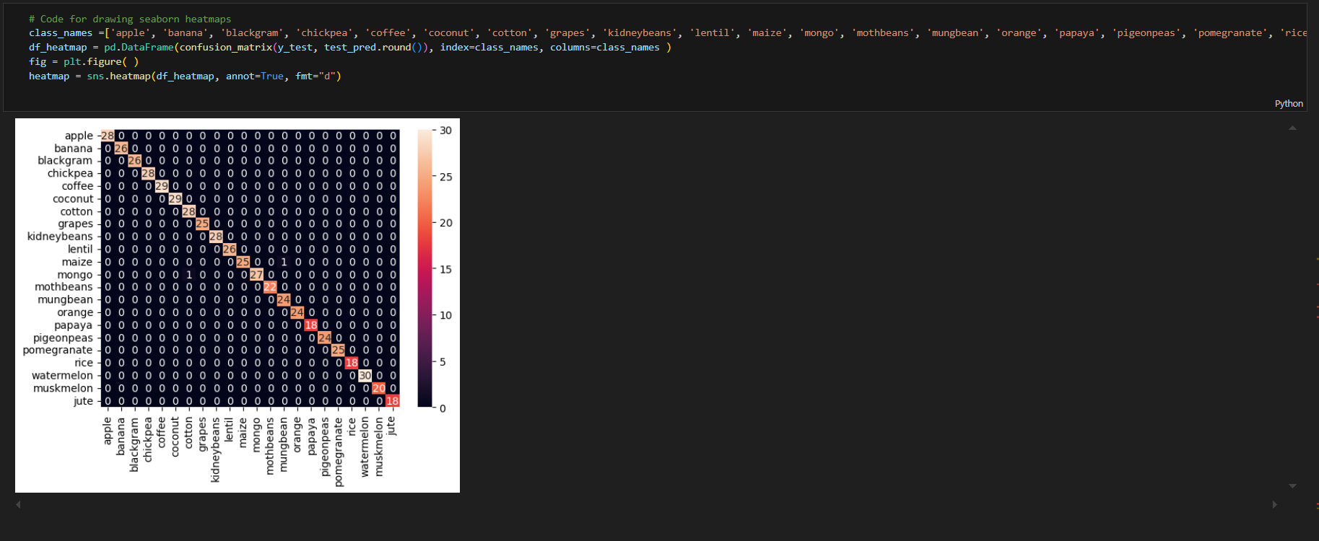
PROJECT IMPLEMENTATION

Slide 34
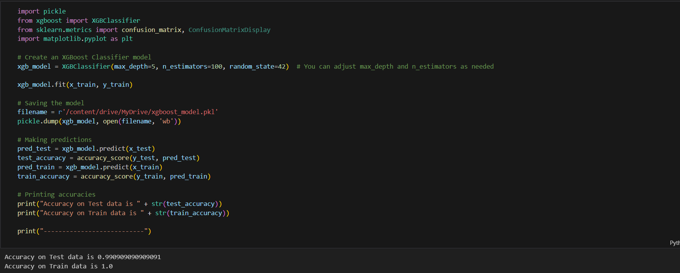
PROJECT IMPLEMENTATION

Slide 35
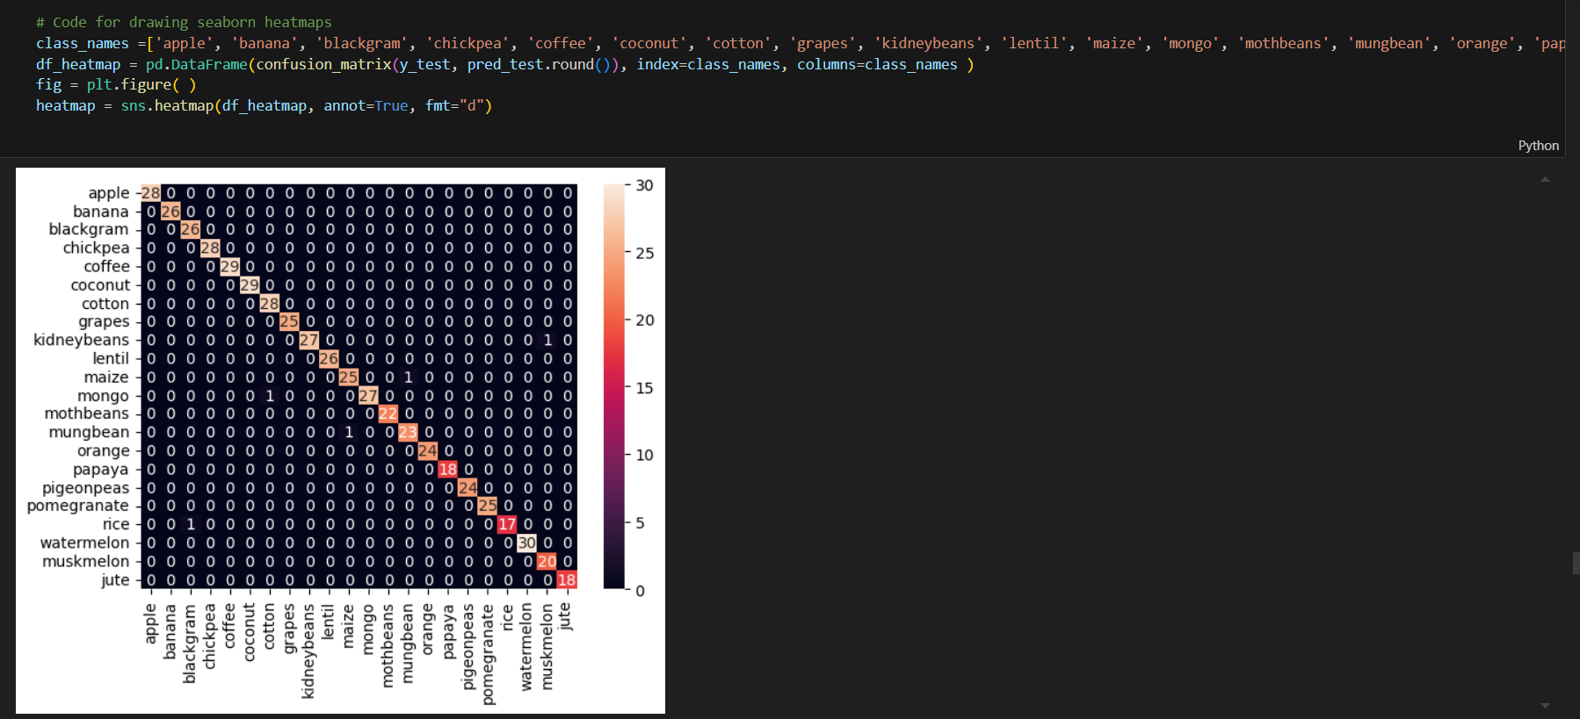
PROJECT IMPLEMENTATION

Slide 36
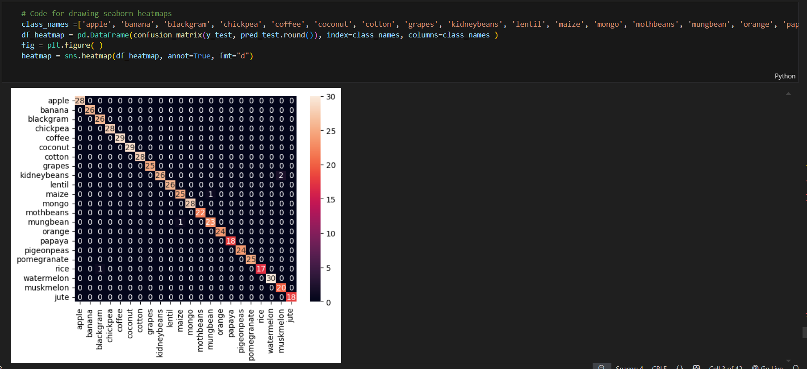
PROJECT IMPLEMENTATION

Slide 37
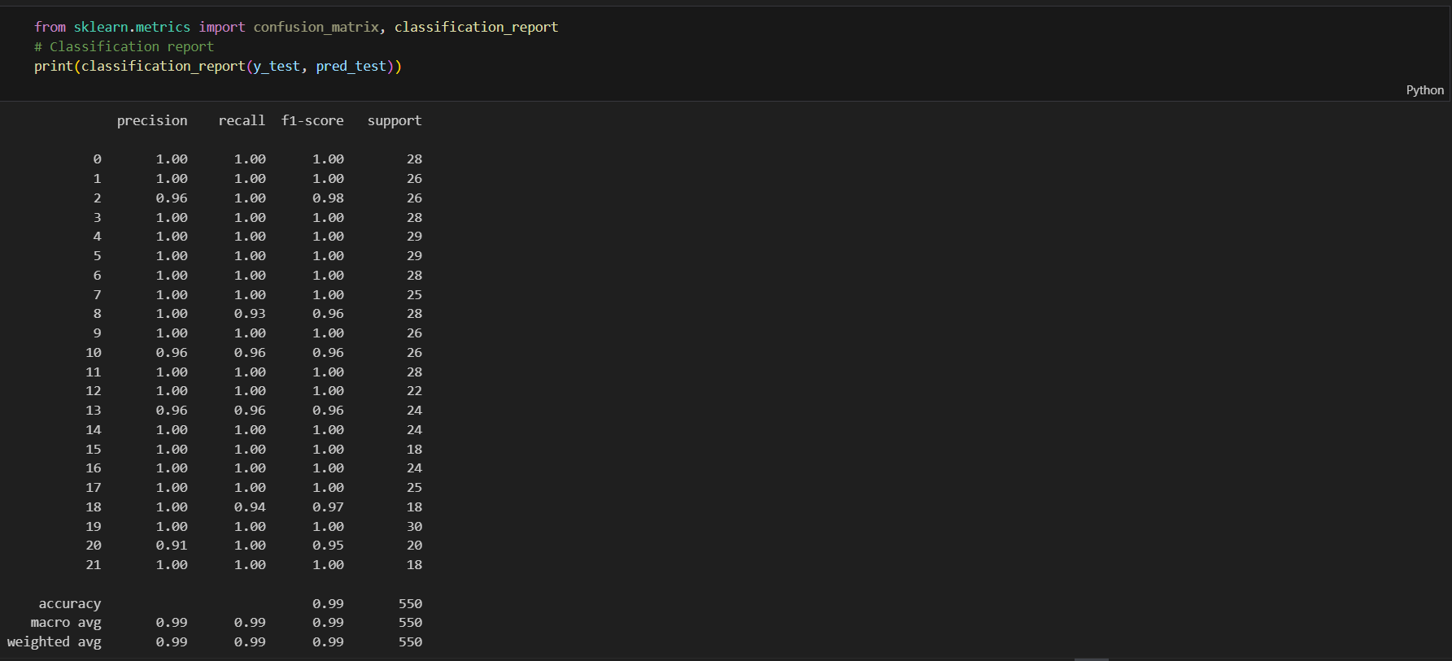
PROJECT IMPLEMENTATION

Slide 38
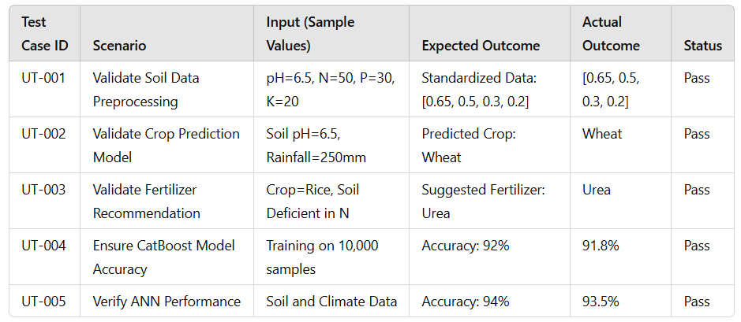
TESTING
1. Unit Testing
Ensures that individual components such as text preprocessing feature extraction, and model prediction work correctly. It validates whether input text is properly tokenized, stopwords are removed, and emotions are classified accurately.

Slide 39
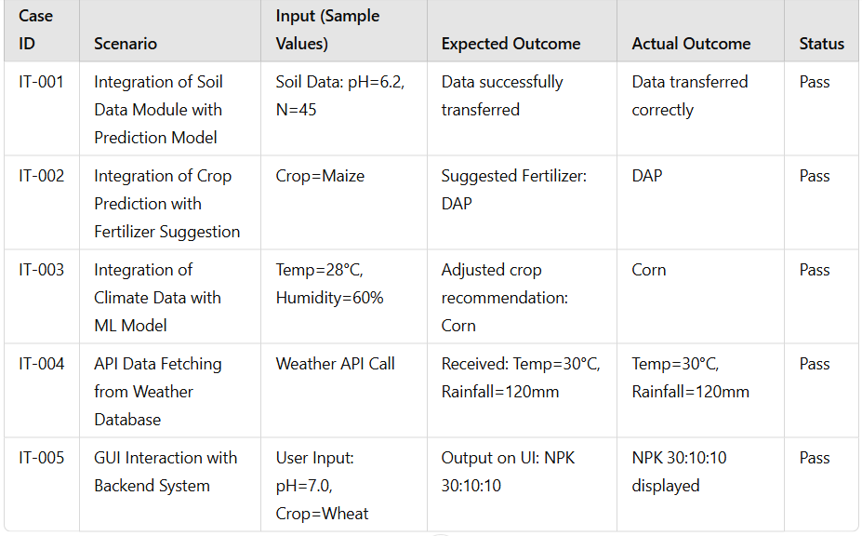
TESTING CONT…
2. Integration Testing
Verifies that different modules such as text preprocessing, feature extraction, and classification work together as expected. It checks for smooth data flow between these components without errors

Slide 40
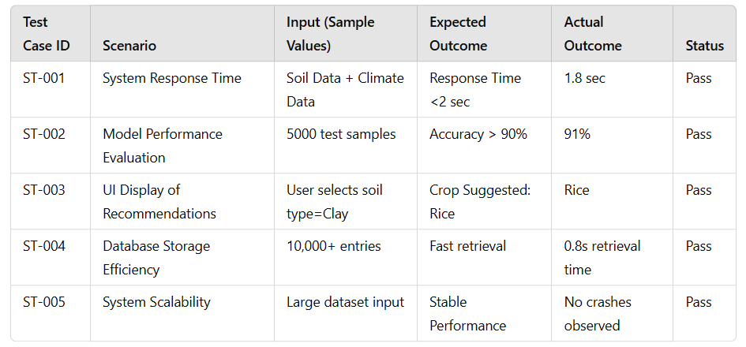
TESTING CONT…
3. System Testing
Evaluates the overall system performance, ensuring it meets functional and non-functional requirements. It validates accuracy, processing speed, and system stability under different conditions..

Slide 41
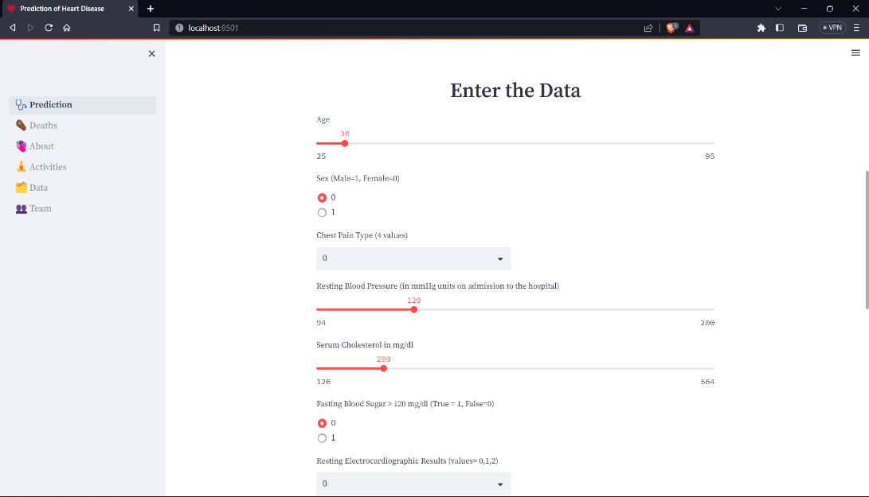
TESTING CONT…
Complete system is tested which includes the machine learning model and streamlit user interface.

Slide 42
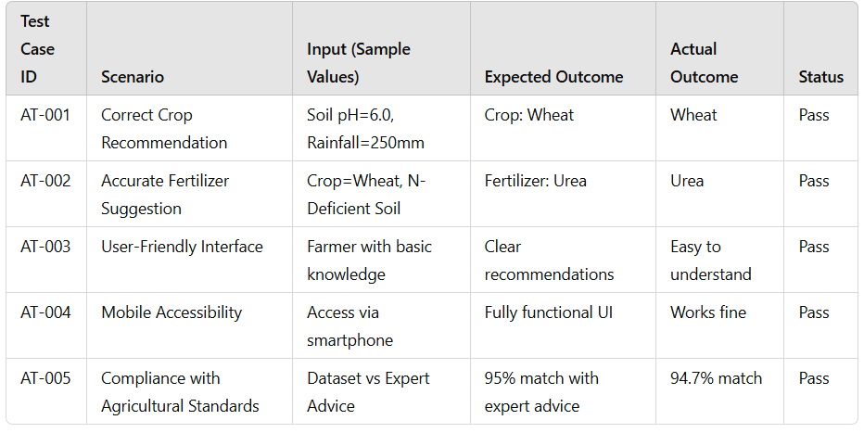
TESTING CONT…
4. Acceptance Testing
Validates the system from a user perspective, ensuring usability and correctness. It checks that users receive accurate emotion predictions, fast response times, and an intuitive interface.

Slide 43
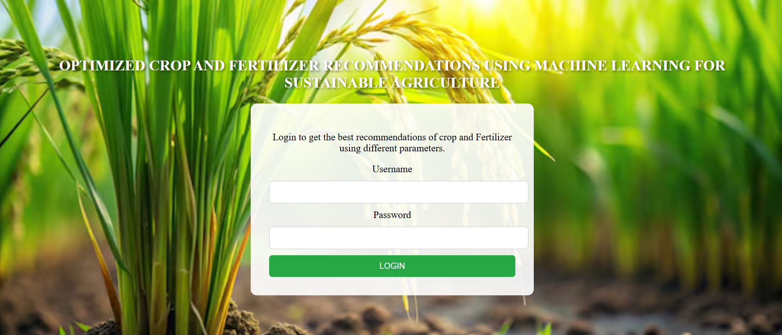
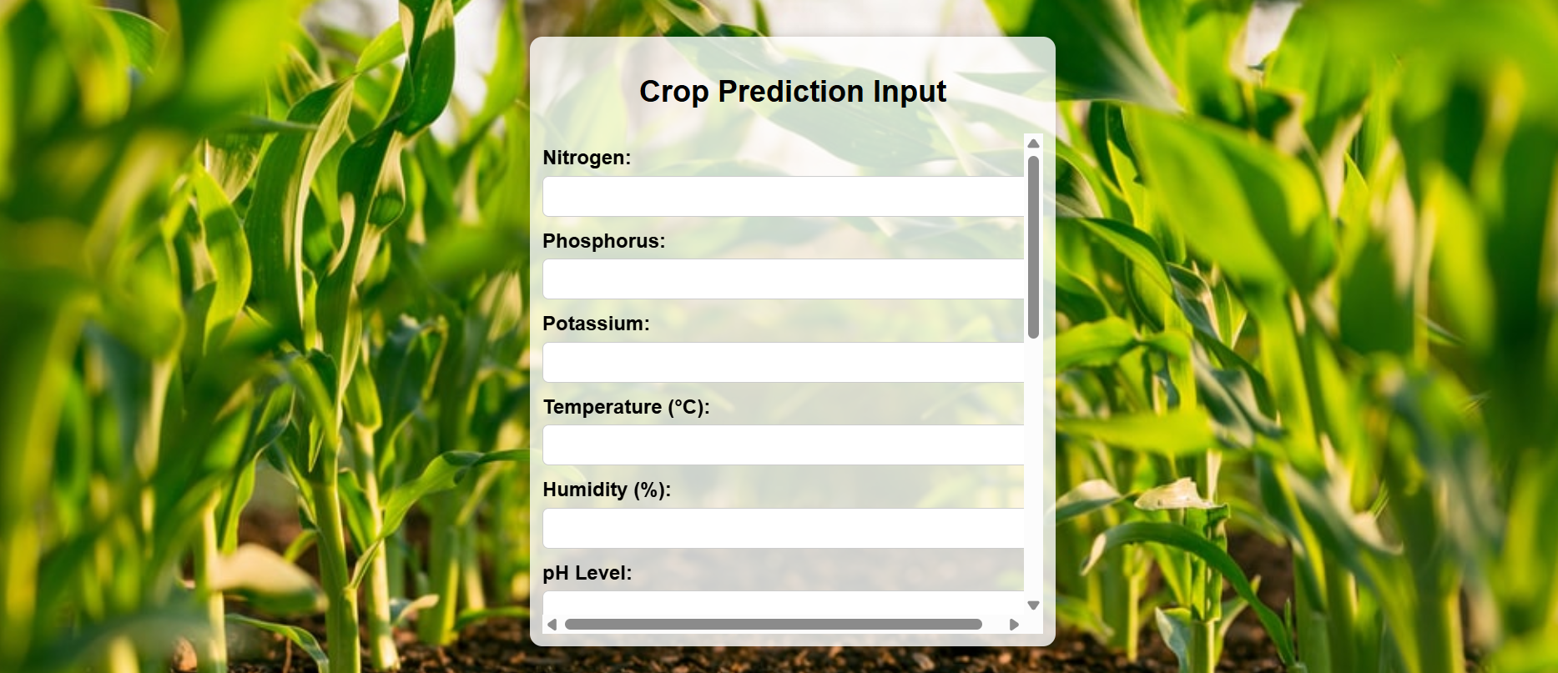
RESULTS

Slide 44
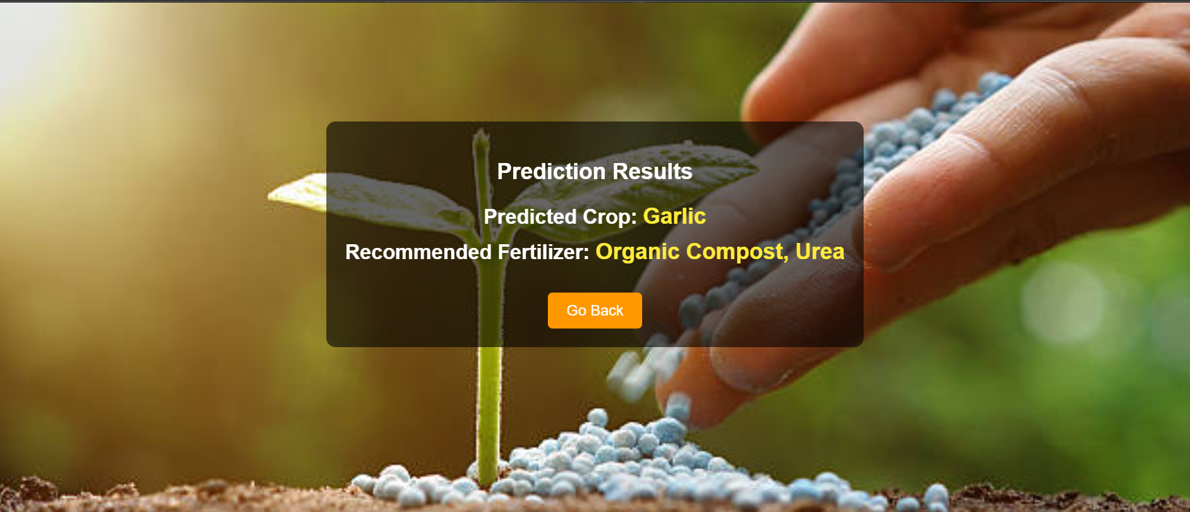
RESULTS

Slide 45
Integration with IoT Sensors
Connect IoT-based soil and climate sensors for real-time data collection, enhancing accuracy in recommendations.
Mobile Application for Farmers
Develop a user-friendly mobile app for easy access to recommendations, weather updates, and personalized alerts.
Blockchain for Data Security
Implement blockchain technology to ensure secure, tamper-proof storage of agricultural data and transactions.
Multi-Language Support
Introduce multilingual interfaces to make the system accessible to farmers from diverse linguistic backgrounds.
AI-Powered Chatbot Assistance
Deploy an AI chatbot to provide instant support, answer queries, and guide farmers in implementing recommendations effectively.
FUTURE ENHANCEMENT

Slide 46
Improved Agricultural Productivity – Helps farmers increase crop yield by suggesting the most suitable crops and fertilizers.
Optimized Fertilizer Usage – Reduces overuse of fertilizers, preventing soil degradation and enhancing sustainability.
Data-Driven Decision Making – Uses AI/ML models to provide accurate recommendations based on real-time soil and weather data.
Cost-Effective Farming – Saves farmers’ resources by recommending only the necessary fertilizers and crops, reducing waste.
Climate-Resilient Agriculture – Helps farmers adapt to changing climate conditions by suggesting the best crop choices.
Scalability & Accessibility – Can be integrated into mobile applications and IoT devices for easy farmer access.
Support for Small-Scale Farmers – Enables small and marginal farmers to make informed choices, improving their economic conditions.
Future Expansion Possibilities – Can be extended to AI-powered Chatbots, IoT-based soil monitoring, and Blockchain for agricultural trade security.
CONCLUSION :

Slide 47


